Slide 1
Predicting Restaurant Ratings
Presented By Smriti Keshri for Mentorness
Under Batch MIP-ML-15
Date: 07/08/2024

Slide 2
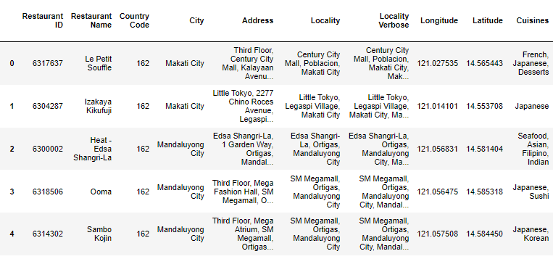
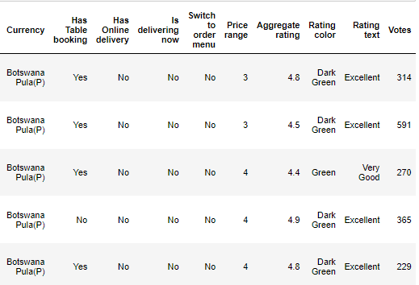
Import the Dataset

Slide 3
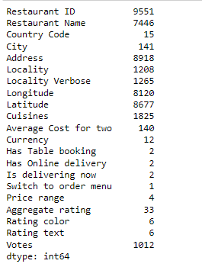
Checking number of unique values

Slide 4
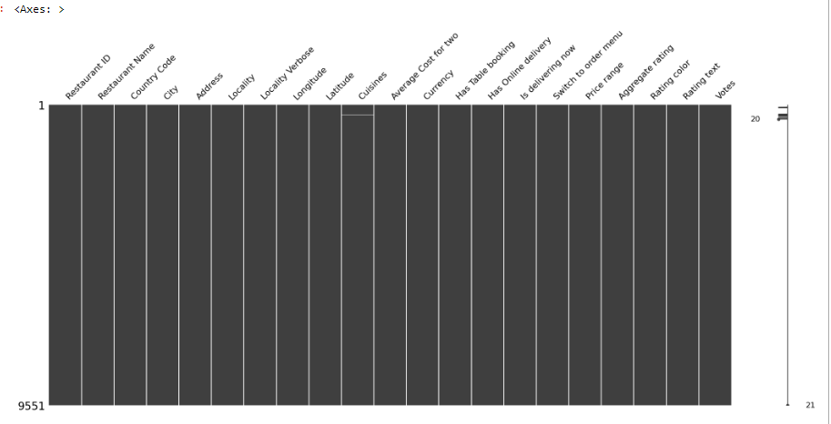
Data visualization for checking is there any null values present in the dataset

Slide 5
Dropping the missing values from the datasets as there is only 8 rows information are not present in cuisines
Remove the unnecessary features from the datasets Restaurant ID, Restaurant Name, Locality Verbose, Switch to order menu values
Now there are total 9542 rows × 17 columns

Slide 6
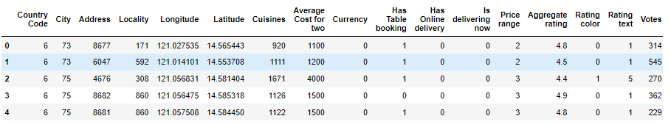
Encoding the categorical dataset

Slide 7
Linear Regression Model
Mean Squared Error: 1.0875
R^2 Score: 0.5251

Slide 8
Decision Tree Regressor Model
Mean Squared Error: 0.0532
R^2 Score: 0.9767

Slide 9
Thank You

